Slide 1
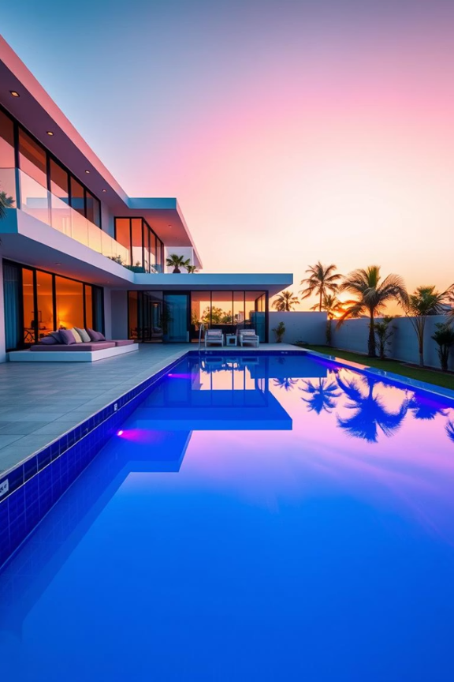

NEXTHIKE IT SOLUTIONS
Exploratory Data Analysis (EDA) for Real Estate Pricing
Mr. Aniket G. Tayade.

Slide 2
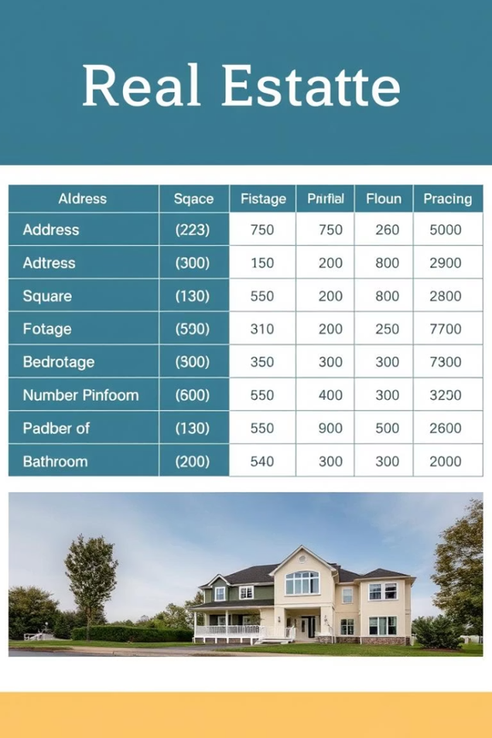
PROBLEM STATEMENT
Key Points:
Real estate pricing is complex due to multiple influencing factors.
Need data-driven insights to optimize pricing strategies.
Goal:
Identify key variables affecting house prices using EDA.

Slide 3

Understanding Our Data
Dataset: Housing Data.csv
Contains 1460 Rows x 81 Columns features (numeric & categorical).
Key variables:
SalePrice (Target)
GrLivArea (Living area)
OverallQual (Quality rating)
Neighborhood,
YearBuilt,
GarageArea, etc.

Slide 4

Data Cleaning & Preprocessing
There are 1369 Missing Values in column Alley, 872 in MasVnrType, 81 in GarageYrBlt and 1 in Electrical column.
Drop columns with more than 15% missing values. Drop columns like Alley, MasVnrType.
For numerical columns, fill with median and for categorical columns, fill with mode.

Slide 5
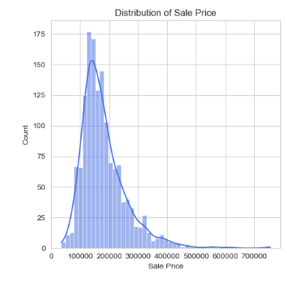
Univariate Analysis
Insights : Distribution of Sale Price (Histogram with KDE)
Distribution is right-skewed, indicating more low-priced houses.
Most sale prices fall between 100,000 and 200,000.
Fewer houses are priced above 400,000, indicating rare high-end properties.
The peak (mode) is around 130,000–140,000.
KDE curve confirms the non-normal shape of the data.
Presence of a long tail suggests potential outliers or luxury properties.

Slide 6
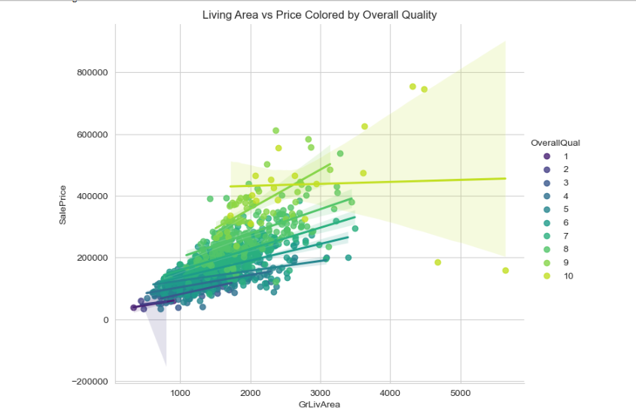
Bivariate Analysis
Insights: GrLivArea (Above Ground Living Area) vs SalePrice with OverallQual Coloring
Strong positive correlation: As GrLivArea increases, SalePrice generally increases too.
Lighter colors (high OverallQual) cluster at higher prices.
Darker colors (low OverallQual) mostly stay at lower prices, even for bigger houses.
A small house with OverallQual = 9 or 10 can cost more than a big house with OverallQual = 3 or 4.
GrLivArea and OverallQual together are strong predictors of price.

Slide 7
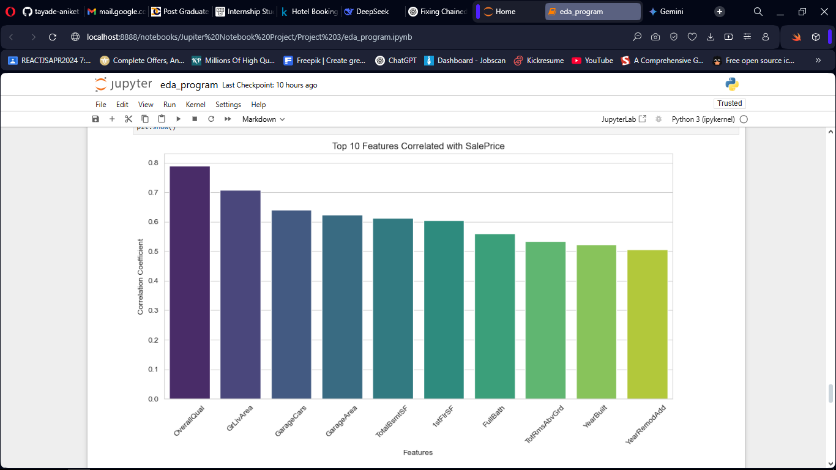
Multivariate Analysis
Insights: Top 10 features with SalePrice
OverallQual has the strongest positive correlation with SalePrice.
GrLivArea (Above ground living area) is the second most positively correlated feature.
GarageCars and GarageArea show strong positive correlations.
TotalBsmtSF (Total basement square feet) also has a substantial positive correlation.
The top 5 features (OverallQual to TotalBsmtSF) exhibit relatively high and similar positive correlations. These are key drivers of sale price.
The correlation coefficients gradually decrease from OverallQual to YearRemodAdd.

Slide 8
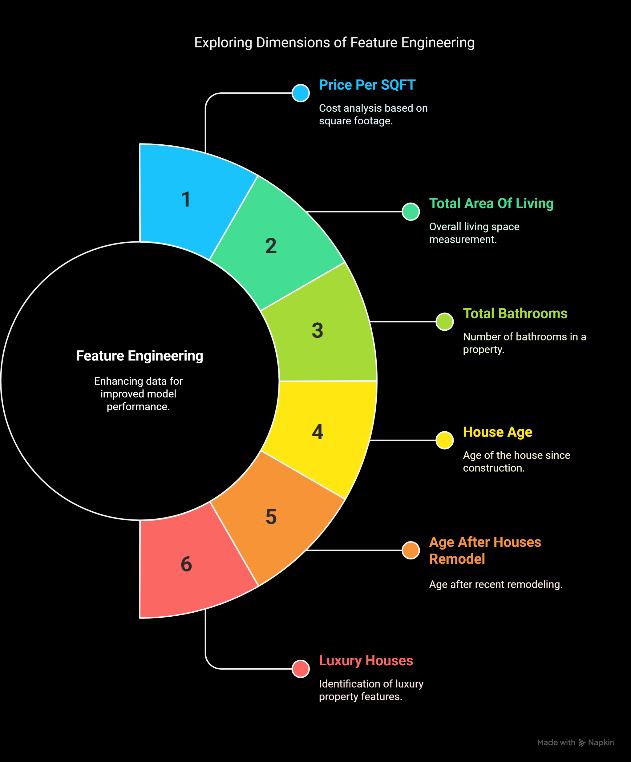
Feature Engineering
Price Per SQFT Measures cost per square foot to understand pricing trends.
Total Area Of Living Total livable space; helps assess property size and value.
Total Bathrooms Number of bathrooms; affects comfort and pricing.
House Age Years since construction; impacts value and maintenance needs.
Age After Houses Remodel Time since last remodel; newer remodels may increase appeal.
Luxury Houses Flags high-end properties based on premium features.

Slide 9
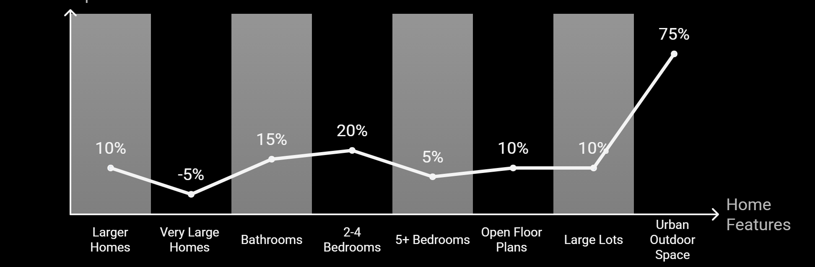
Size Impact on Pricing
Ceiling Height & Layout Matter - Open Floor Plans increase perceived space.
Outdoor Space Premium - Larger lots (>10,000 sq. ft.) add ~5–15% to price in suburban areas. Urban Areas Outdoor space (balconies, terraces) adds ~50–50–100/sq. ft.
Bathrooms Add Significant Value - Buyers prefer convenience and privacy (e.g., en-suite bathrooms).
Larger Homes Command Higher Prices - Buyers associate size with more living space, storage, and luxury.
Price per Sq. Ft. Decreases for Very Large Homes - Luxury buyers prioritize amenities/quality over sheer size.
Bedrooms vs. Price: Not Always Linear - 2–4 Bedrooms: Strong price increase (family demand). 5+ Bedrooms: Smaller premium (niche market).

Slide 10
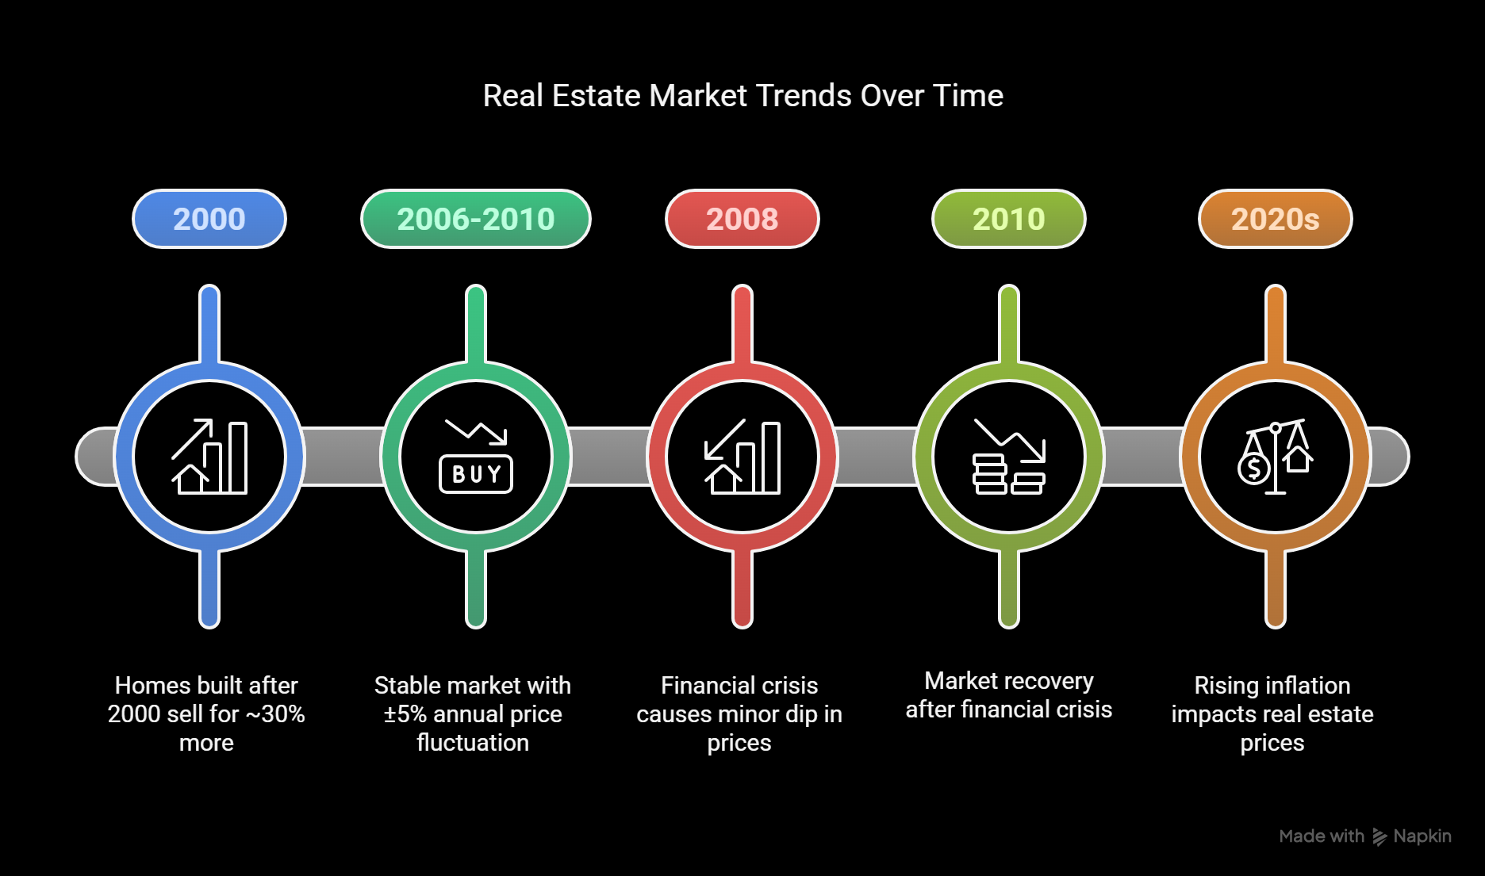
Market Trends Over Time

Slide 11
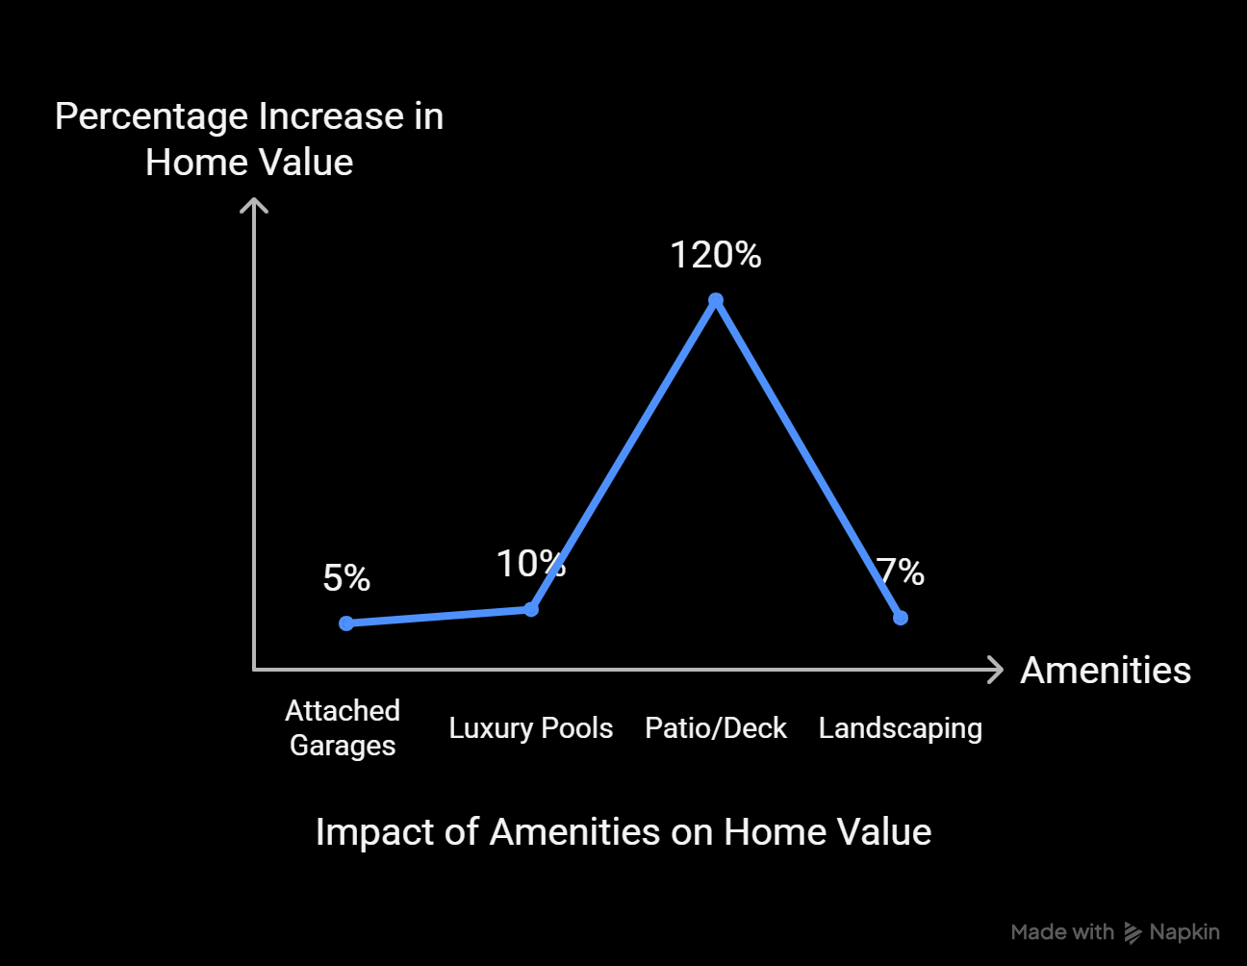
Amenities Impact
Garage: Space = Value – The Correlation between GarageCars vs. SalePrice is (0.64). Buyers prioritize storage, EV charging, and weather protection. Attached Garages boost value 5% more than detached.
Fireplaces: Cozy but Diminishing Returns - 1 Fireplace: Adds ~5K – 5K–12K (luxury perception).
2+ Fireplaces: Only + 3K–3K–8K extra (redundant for most buyers).
Pools: Niche Appeal - Standard Pools (<$20K investment): +1–3% to home value. Luxury Pools (infinity, heated): +5–10% (high-end markets only).
Central Air Conditioning (HVAC) - Adds ~10K – 10K–15K in hot climates (e.g., Texas, Florida). Minimal impact in temperate regions (e.g., Pacific Northwest).
Landscaping: Well-maintained yards add ~3–7% to value.

Slide 12
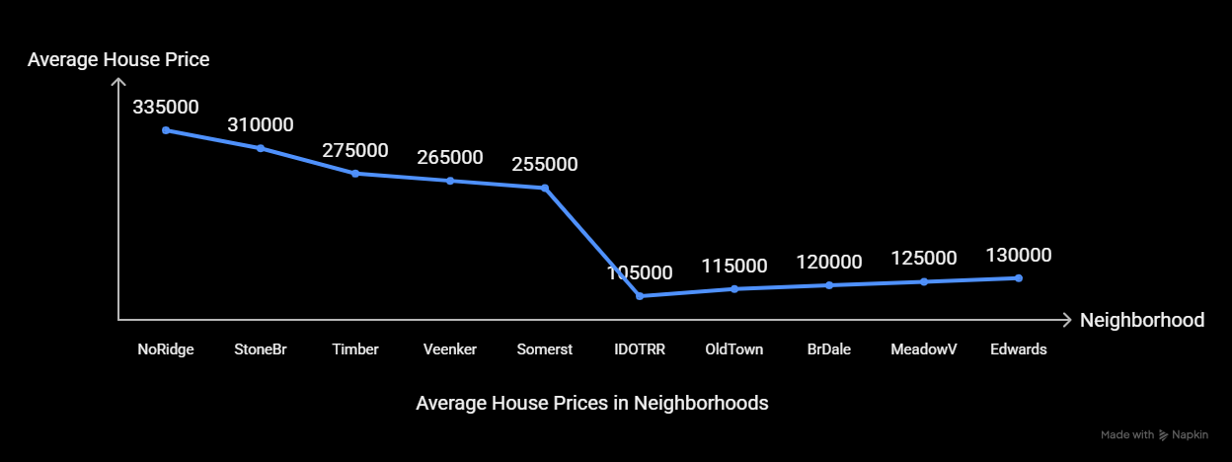
Neighborhood Analysis
Premium Neighborhoods
Top schools (e.g., NoRidge HS rated 9/10).
Low crime rates (StoneBr: 60% safer than city avg.).
Proximity to amenities (parks, shopping, highways).
Affordable Neighborhoods
Older homes (avg. year built: 1940s).
Higher crime (IDOTRR: 2× city avg.).
Limited amenities (fewer parks, longer commutes).

Slide 13
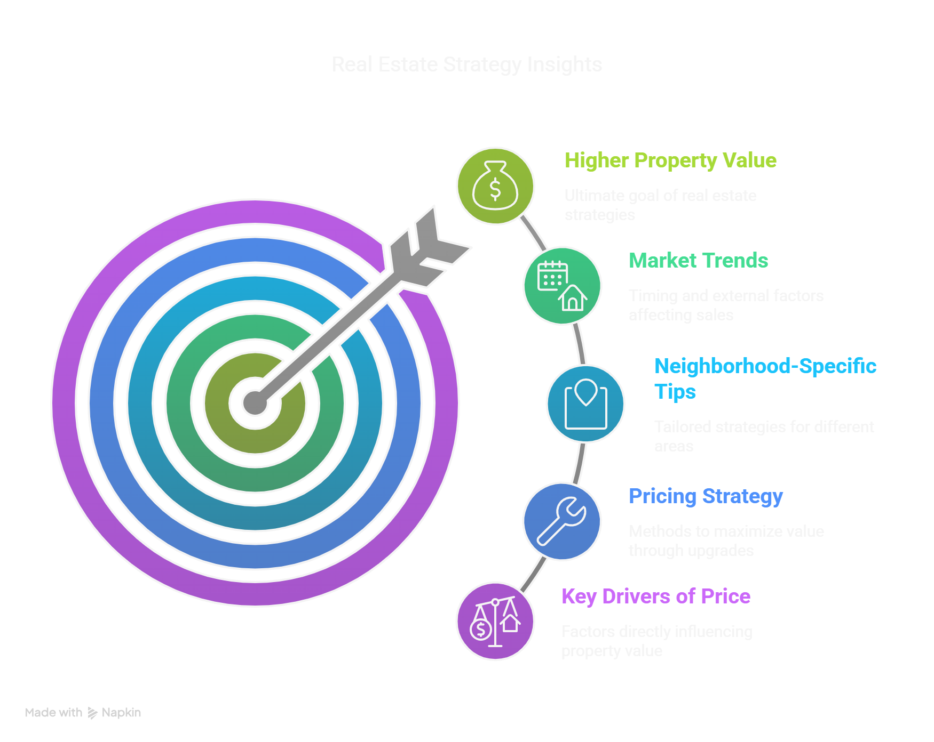
Key Insights & Recommendations
1. Top Drivers of Price - Overall Quality (0.79 correlation), Living Area (GrLivArea) (0.71 correlation), Garage Size (0.64 correlation), etc.
2. Pricing Strategy - Kitchens: ROI of 80–120% (modern appliances, quartz counters). Add 10K–10K–20K per full bathrooms.
3. Market Trends - Newer Homes Sell Faster, Homes built after 2000 sell 30% faster than pre-1980s. Seasonal Timing List in May–June: 7% higher offers. Avoid December: 5% fewer buyers.
4. Neighborhood Specific Tips - Premium Areas (NoRidge, StoneBr) Highlight school districts and low crime in listings. Value Areas (IDOTRR, OldTown) Renovate kitchens/bathrooms for 20% ROI.

Slide 14

Thank You!
Grateful for your time and attention. Your feedback and insights are deeply appreciated!

